Slide 1
Greatest common divisor (GCD) and Least common multiple (LCD)

Slide 2


Slide 3
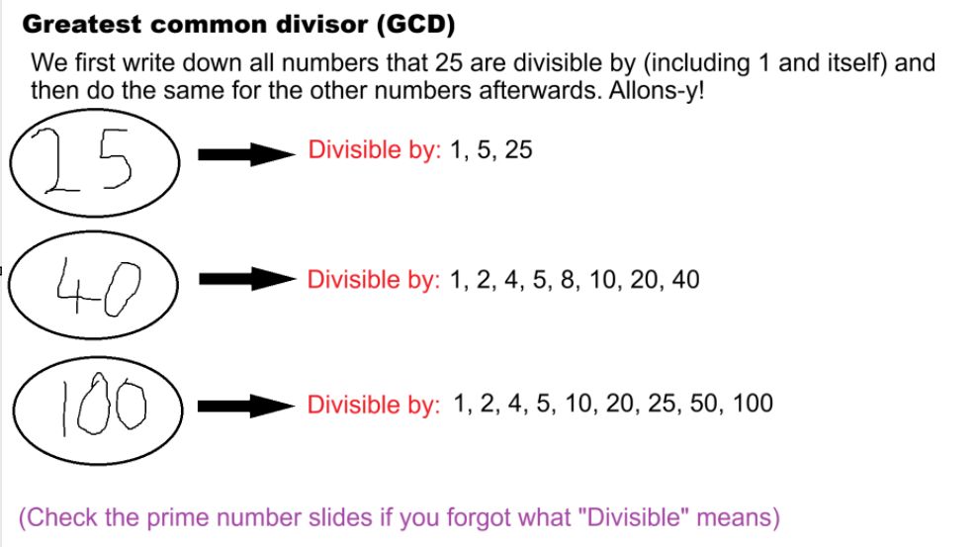

Slide 4
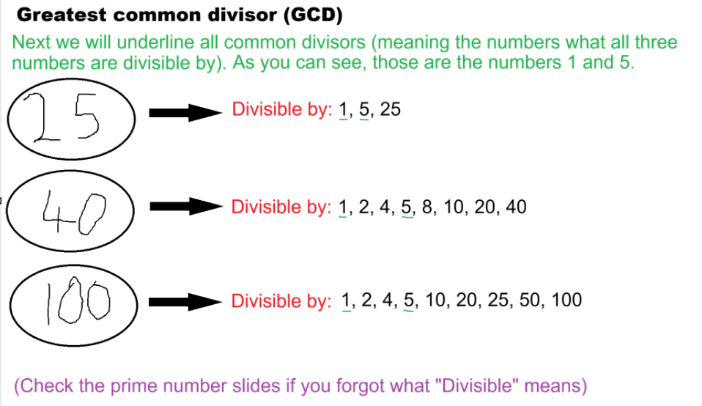

Slide 5
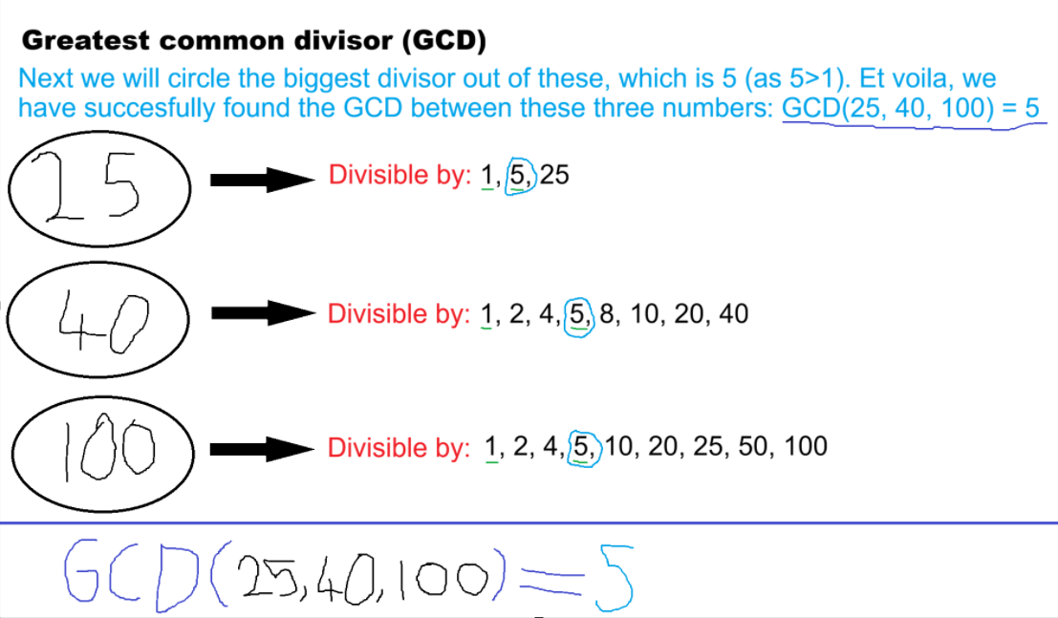

Slide 6
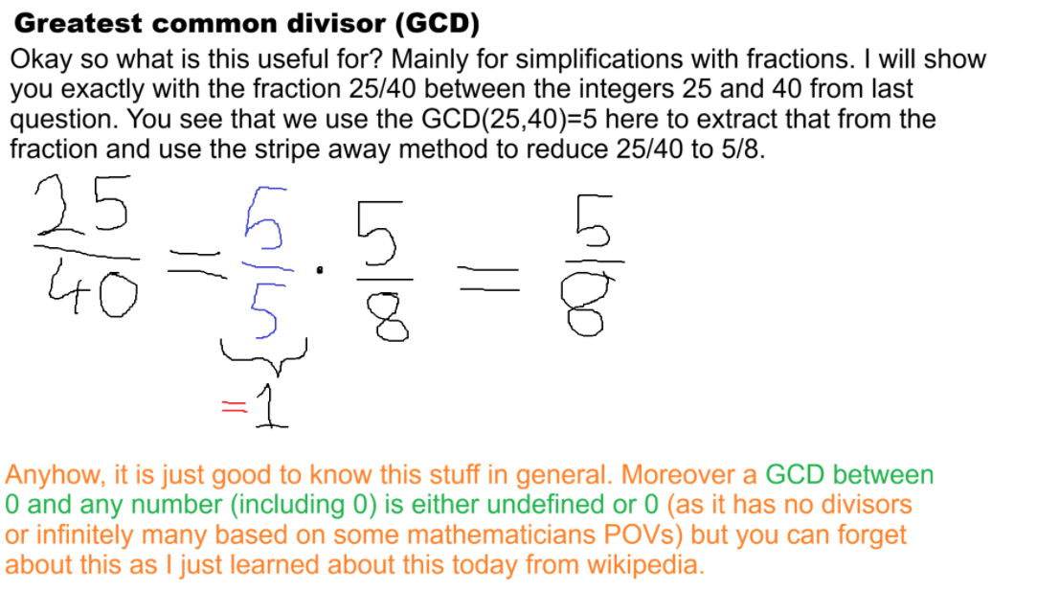

Slide 7


Slide 8
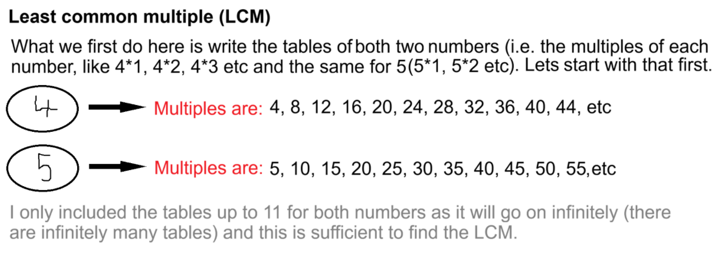

Slide 9


Slide 10
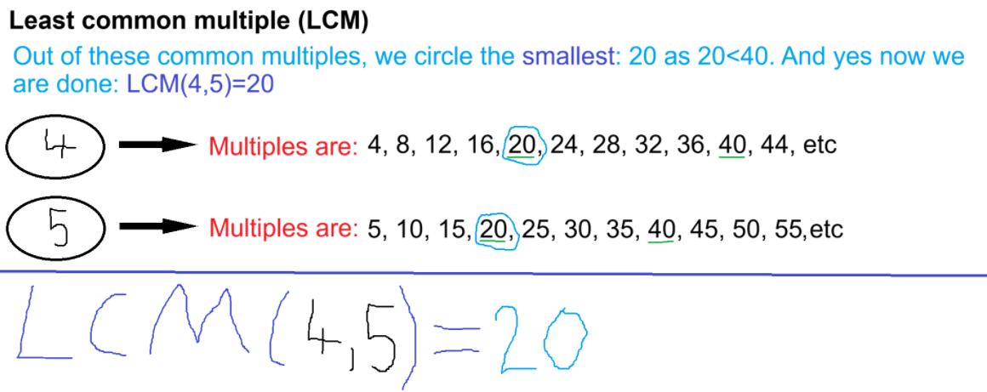

Slide 11
